Slide 1
History Subject for High School: Capitalism
Here is where your presentation begins

Slide 2
Contents of this template
You can delete this slide when you’re done editing the presentation
Fonts | To view this template correctly in PowerPoint, download and install the fonts we used
Used and alternative resources | An assortment of graphic resources that are suitable for use in this presentation
Thanks slide | You must keep it so that proper credits for our design are given
Colors | All the colors used in this presentation
Icons and infographic resources | These can be used in the template, and their size and color can be edited
Editable presentation theme | You can edit the master slides easily. For more info, click here
For more info:
SLIDESGO | BLOG | FAQs
You can visit our sister projects:
FREEPIK | FLATICON | STORYSET | WEPIK | VIDEVO

Slide 3
Table of contents
01
02
03
04
What is capitalism and its historical origin?
You can describe the topic of the section here
Characteristics of capitalism
You can describe the topic of the section here
Stages and theories
You can describe the topic of the section here
Capitalism today
You can describe the topic of the section here

Slide 4
Whoa!
This can be the part of the presentation where you introduce yourself, write your email…

Slide 5
01
What is capitalism and its historical origin?
You can enter a subtitle here if you need it

Slide 6
What is capitalism?
Mercury is the closest planet to the Sun and the smallest one in the entire Solar System. This planet’s name has nothing to do with the liquid metal, since Mercury was named after the Roman messenger god. Its temperatures aren’t as terribly hot as those on Venus, but are quite high!
Mercury takes a little more than 58 days to complete its rotation, so try to imagine how long days must be there! Since the temperatures are so extreme, albeit not as extreme as on Venus, Mercury has been deemed to be non-habitable for humans

Slide 7
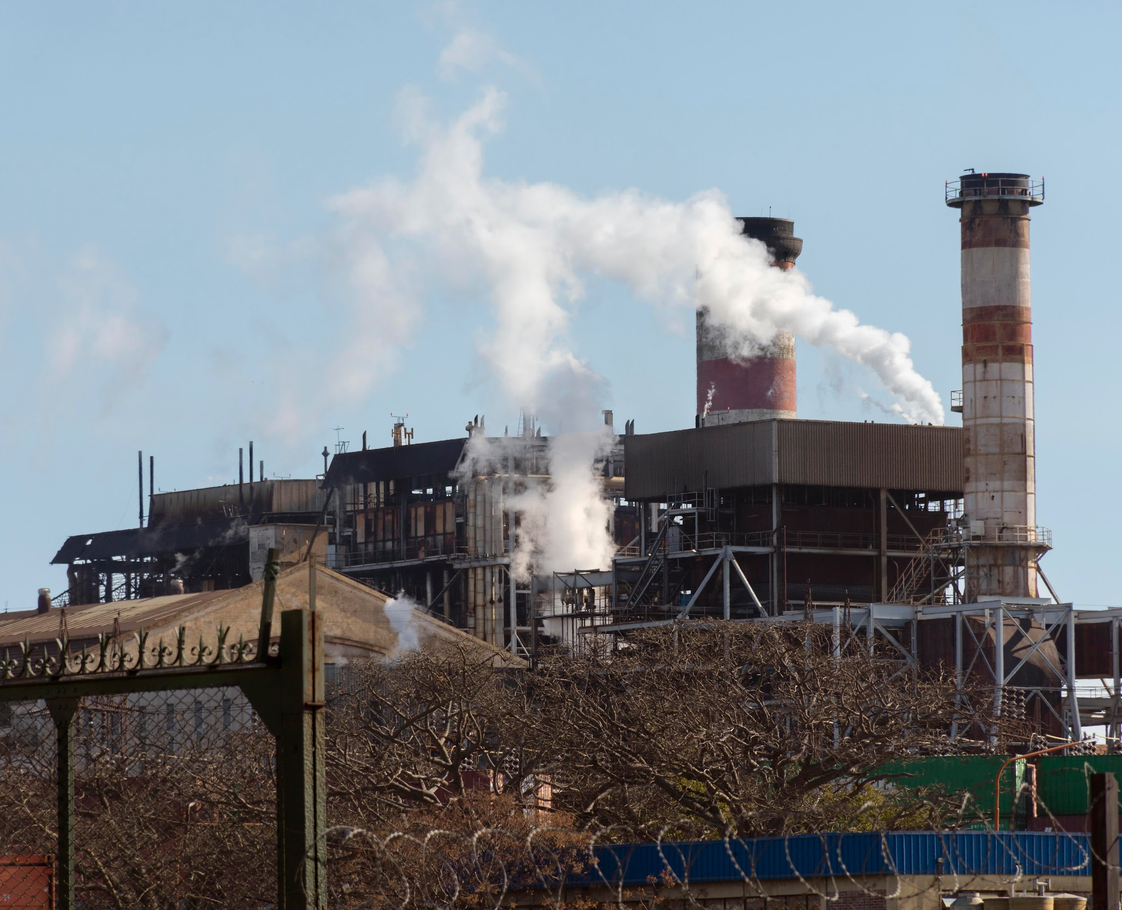
Historical context
Do you know what helps you make your point crystal clear? Lists like this one:
They’re simple
You can organize your ideas clearly
You’ll never forget to buy milk!
And the most important thing: the audience won’t miss the point of your presentation

Slide 8
Historical origins
Renaissance
Protestant Reformation
Mercury is the closest planet to the Sun and the smallest one in the Solar System—it’s only a bit larger than the Moon
Venus has a beautiful name and is the second planet from the Sun. It’s a hot planet and has a poisonous atmosphere

Slide 9
Main characteristics of capitalism
Private
property
Competition among citizens
Pursuit of economic profit
Mercury is the closest planet to the Sun and the smallest of them all
Venus has a beautiful name and is the second planet from the Sun
Despite being red, Mars is actually a cold place. It’s full of iron oxide dust

Slide 10
Free market
Market
supply
Market
prices
Venus is the second planet from the Sun
Jupiter is the biggest planet in the Solar System
Market
demand
Production of goods and services
Despite being red, Mars is a cold place
Saturn is a gas giant and has several rings

Slide 11
Private property
Obtain land
Obtain housing
Obtain shares
Despite being red, Mars is actually a cold place
Venus is the second planet from the Sun
Neptune is the farthest planet from the Sun
Obtain bonds
Obtain commodities
Obtain goods
Mercury is the closest planet to the Sun
Saturn is a gas giant and has several rings
Jupiter is the biggest planet of them all

Slide 12
Competition
Competition between companies
Saturn is a gas giant and has several rings. It’s composed mostly of hydrogen and helium
Boosts
innovation
Improves product quality
Improve service quality
Mercury is the closest planet to the Sun
Saturn is a gas giant and has several rings
Jupiter is the biggest planet of them all

Slide 13
Awesome words

Slide 14
—Someone Famous
“This is a quote, words full of wisdom that someone important said and can make the reader get inspired”

Slide 15
A picture always reinforces
the concept
Images reveal large amounts of data, so remember: use an image instead of a long text. Your audience will appreciate it

Slide 16
4,498,000
Big numbers catch your audience’s attention

Slide 17
35M
25M
23K
Despite being red, Mars is a cold place
Earth is the third planet from the Sun
Saturn is a gas giant and has several rings

Slide 18
Socioeconomic classes
15%
5%
75%
The bourgeoisie
Business owners
Working class
Jupiter is the biggest planet of them all
Neptune is the farthest planet from the Sun
Venus is the second planet from the Sun

Slide 19
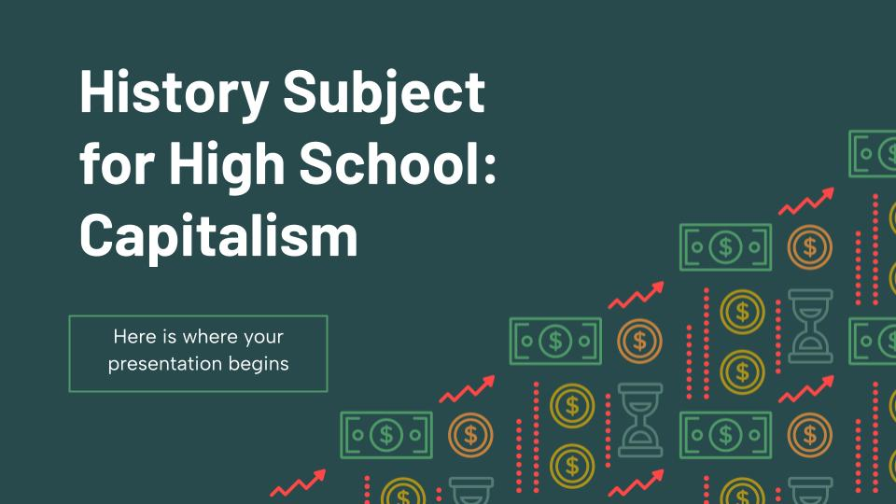
Desktop software
You can replace the image on the screen with your own work. Just right-click on it and select “Replace image”

Slide 20
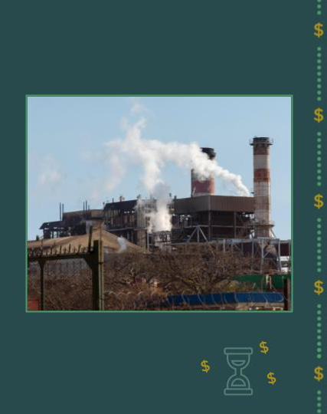
Tablet
app
You can replace the image on the screen with your own work. Just right-click on it and select “Replace image”

Slide 21
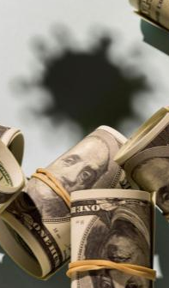
Mobile
app
You can replace the image on the screen with your own work. Just right-click on it and select “Replace image”

Slide 22
First capitalist countries
85%
65%
45%
Netherlands
Jupiter is the biggest planet of them all
Great Britain
Neptune is very far from the Sun
Italy
Mars is actually a very cold place

Slide 23
Stages of capitalist development
1300-1880
1880-1980
1880-Today
Mercury is the closest planet to the Sun and the smallest one in the Solar System. This planet’s name has nothing to do with the liquid metal
Venus has a beautiful name and is the second planet from the Sun. It’s terribly hot, even hotter than Mercury, and its atmosphere is extremely poisonous
Earth is the third planet from the Sun and the only one that harbors life in the Solar System. All humans live on this planet

Slide 24
Capitalist countries in the world
Country | Capital | Population
Germany | Berlin | 81,083,600
Spain | Madrid | 46,439,864
France | Paris | 66,616,416
England | London | 55,980,000
South Korea | Seoul | 49,540,000
United States | Washington, D. C. | 316,017,000
New Zealand | Wellington | 4,699,755

Slide 25
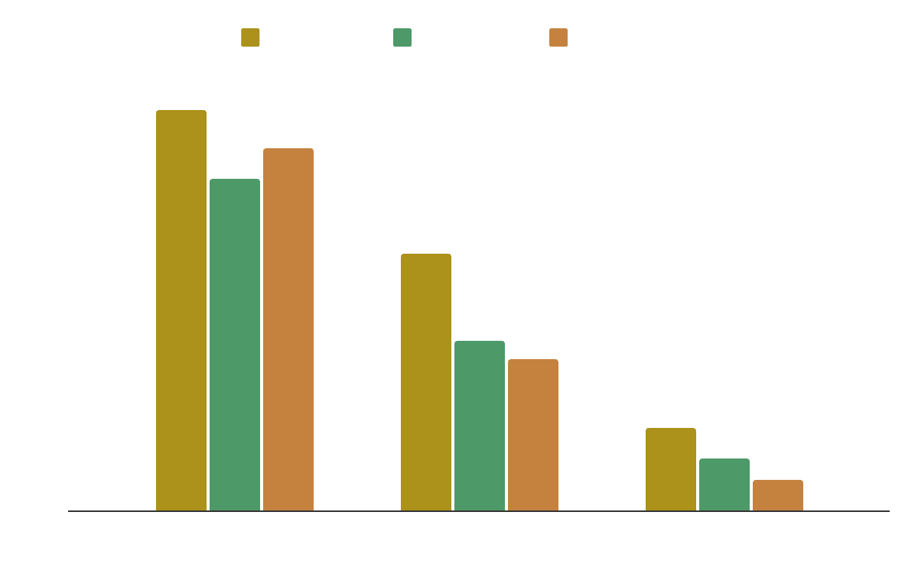
Social classes in the world
10%
25%
65%
Upper class
Jupiter is the biggest planet of them all
Middle class
Neptune is very far from the Sun
Lower class
Mars is actually a very cold place
Follow the link in the graph to modify its data and then paste the new one here. For more info, click here

Slide 26
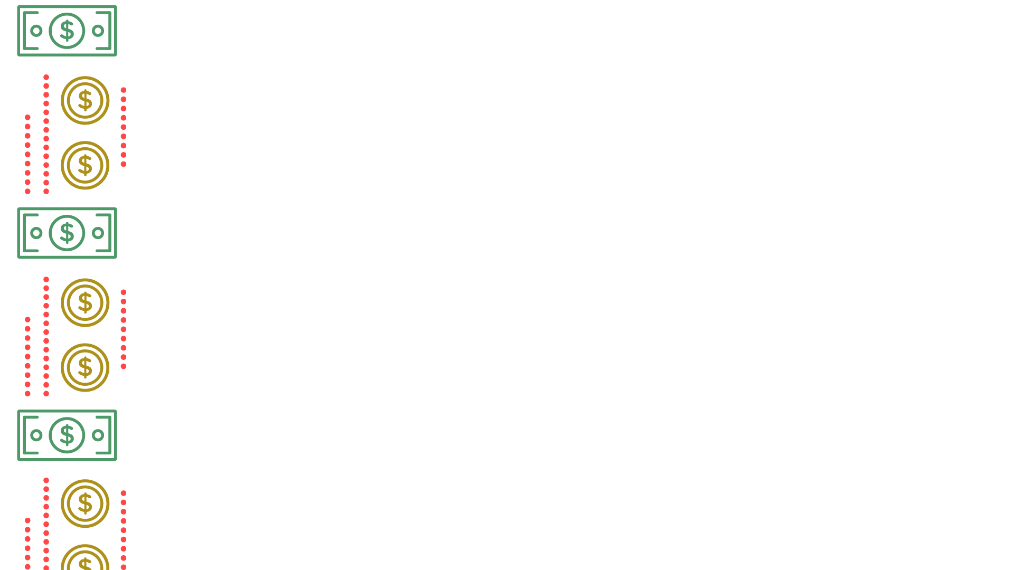
04
Capitalism today
You can enter a subtitle here if you need it

Slide 27
Pros and cons of capitalism
Complete the table with the advantages and disadvantages of capitalism
Advantages of capitalism | Disadvantages of capitalism

Slide 28
Economic benefit
Productive
work
Capital investment
Capitalism
Jupiter is the biggest planet of them all
Neptune is very far from the Sun
The main objective of capitalism is to obtain profits through…
Individual enrichment
For-profit associations
Economic growth of society

Slide 29
Fathers of capitalism
Complete the table with the main figures of capitalism
Name | Details
 | Jupiter is a big planet
 | Pluto is a dwarf planet
 | Saturn is a gas giant
 | Mars is a very cold place
 | Mercury is a small planet

Slide 30
Background of capitalism
Complete the box with the names of the causes that lead to the birth of capitalism
Historical origin of capitalism
Saturn is a gas giant and has several rings. It’s composed mostly of hydrogen and helium
Massification of work by the first machines
Independent economic system
Industrial mode of production

Slide 31
Invisible hand theory
Clay William
Market economics
Free competition
Free competition
Contributes to the maximum social well-being

Slide 32
Main criticisms of capitalism
Saturn is a gas giant and has several rings. It’s composed mostly of hydrogen and helium. It was named after the Roman god of wealth and agriculture
Neptune is the farthest planet from the Sun. It’s also the fourth-largest planet by diameter in the Solar System
Earth is the third planet from the Sun and the only one that harbors life in the Solar System. All humans live on this planet
Despite being red, Mars is actually a cold place. It’s full of iron oxide dust, which gives the planet its reddish cast

Slide 33
Thanks!
Do you have any questions?
youremail@freepik.com | +34 654 321 432
yourwebsite.com
Please keep this slide for attribution

Slide 34
Alternative resources
Here’s an assortment of alternative resources whose style fits that of this template:
Vectors:
Free vector retro background of banknotes and coins

Slide 35
Resources
Did you like the resources on this template? Get them on our other websites:
Vectors:
Free vector retro background of banknotes and coins
Photos:
Pollution concept of factory emisions
Free photo skyscrapers and blue sky with clouds
Covid-19 global economic crisis
Medium shot smiley woman holding drill
Free photo front view smiley woman holding crossed arms

